Slide 1

Information for Providers

Slide 2
Who is Allegiance?
Our History
Originally founded in 1980, Allegiance has administered Self-Funded Health Plans for more than three decades.
    Over 150 clients across the country representing more than 302,000 lives.
    Clients include hospital systems, school districts and government organizations, insurance trusts, and MEWAs.
    Claims processing, customer service, enrollment, and all other services are coordinated from our corporate office in Missoula, MT.
Allegiance became a wholly-owned subsidiary of Cigna in 2008 enabling us to offer the flexibility and customized service of our TPA model alongside Cigna’s extensive network and analytic products.

Slide 3

Allegiance and Disney
Our Relationship
Allegiance is the third party administrator (TPA) for two of Disney’s HMO plans in Florida.
Employees and their families can access one of two network options in Florida; Florida Hospital or Orlando Health.

Slide 4
Working with Allegiance

Slide 5

Working with Allegiance
Pre-Certification / Pre-Treatment Review
Pre-certification and Pre-treatment Review for services will be coordinated through StarPoint Health Group, an Allegiance company.
StarPoint’s Nurse case managers and reviewers are available by phone at (800) 342-6510
To view the pre-treatment spreadsheet, please go to the client specific web page; www.askallegiance.com/disneyoh and click on the For Providers Only tab in the bottom right hand corner. Once on the provider page, click on the Pre-Treatment Review/Pre-Certification link. On this page you will see Outpatient Pretreatment Review. This will be the page to search for whether a procedure needs to be reviewed.

Slide 6
Working with Allegiance
Submitting Claims
All medical claims must be sent to:
Allegiance
PO Box 3018
Missoula, MT 59806
Payer ID: 81040
The following ancillary and national networks will be accessed through Cigna:
ASHN – Chiropratic CareCentrix – DME/Home Health Quest/Lab Corp
Evicore – High tech radiology Davita/Fresenius

Slide 7
Working with Allegiance
Claims Processing/Payment
All claims are processed by Allegiance at its facility in Missoula, MT.
Checks and EOBs come from Allegiance.
EFT/835 Zelis (877) 828-8770 www.zelispayments.com

Slide 8
Working with Allegiance
Benefits & Questions
Online Verification of Benefits are available at: www.askallegiance.com/disneyoh
Allegiance Customer Service is available from 8a-8p EST, Monday through Friday at (855) 999-1522 An Automated Voice Response system (IVR) is also available 24/7/365 for claims and benefit information.
270/271, 276/277 Transactions Allegiance Payer ID: 81040

Slide 9
Working with Allegiance
Claims Processing/Payment Overview
Process | Contact | Add’l Information
Claim Submission - Medical | Allegiance | PO Box 3018 Missoula, MT 59806 Payer ID: 81040
Claims Submission – Ancillary Providers | Cigna or Ancillary network: ASHN, CareCentrix, Evicore, Lab Corp, Quest, LifeSource, Davita, Fresenius | PO Box 188061 Chattanooga, TN 37422-8061 Payer ID: 62308
Claim Processing | Allegiance | (855) 999-1522
Claim Status | Allegiance | (855) 999-1522 www.askallegiance.com/disneyoh
Claim Payment | Allegiance | (855) 999-1522 www.askallegiance.com/disneyoh

Slide 10
Working with Allegiance
Claims Processing/Payment Overview
Process | Contact | Add’l Information
Pre-Certification / Pre-treatment Review | StarPoint / Allegiance | (800) 342-6510
Payment Refunds | Allegiance | PO Box 3018 Missoula, MT 59806 (855) 999-0295
Pharmacy Prior Authorization | Express Scripts | http://lab.express-scripts.com/providers/physicians Or (800) 753-2851
Benefit Verification | Allegiance | (855) 999-1522 www.askallegiance.com/disneyoh
270/271, 276/277 Transactions | Allegiance | Payer ID: 81040
EFT/835 | Zelis | (877) 828-8770 www.zelispayments.com

Slide 11
Additional Information

Slide 12
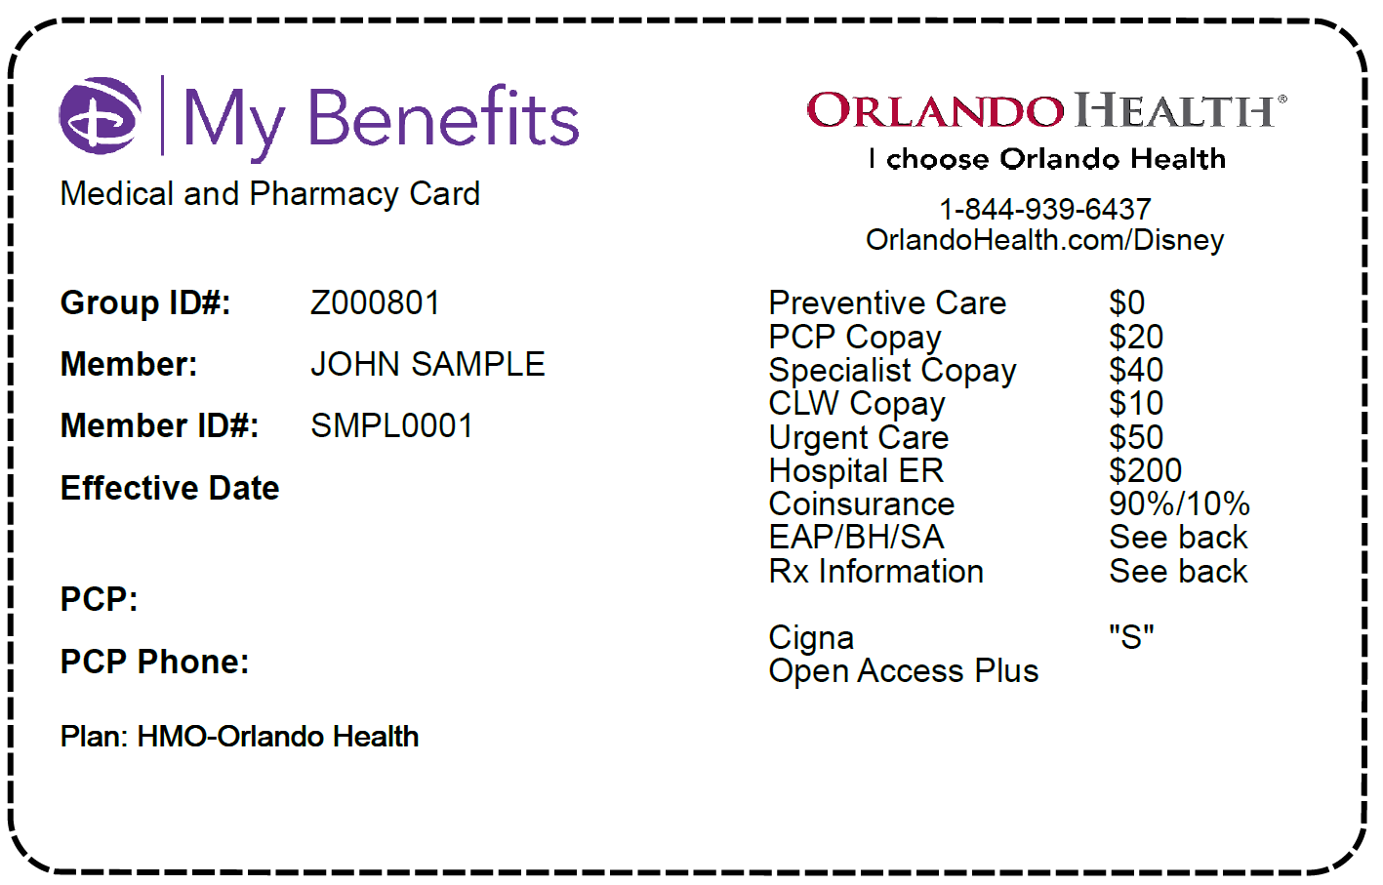
New Member Identification Cards
Sample ID Card (front)

Slide 13
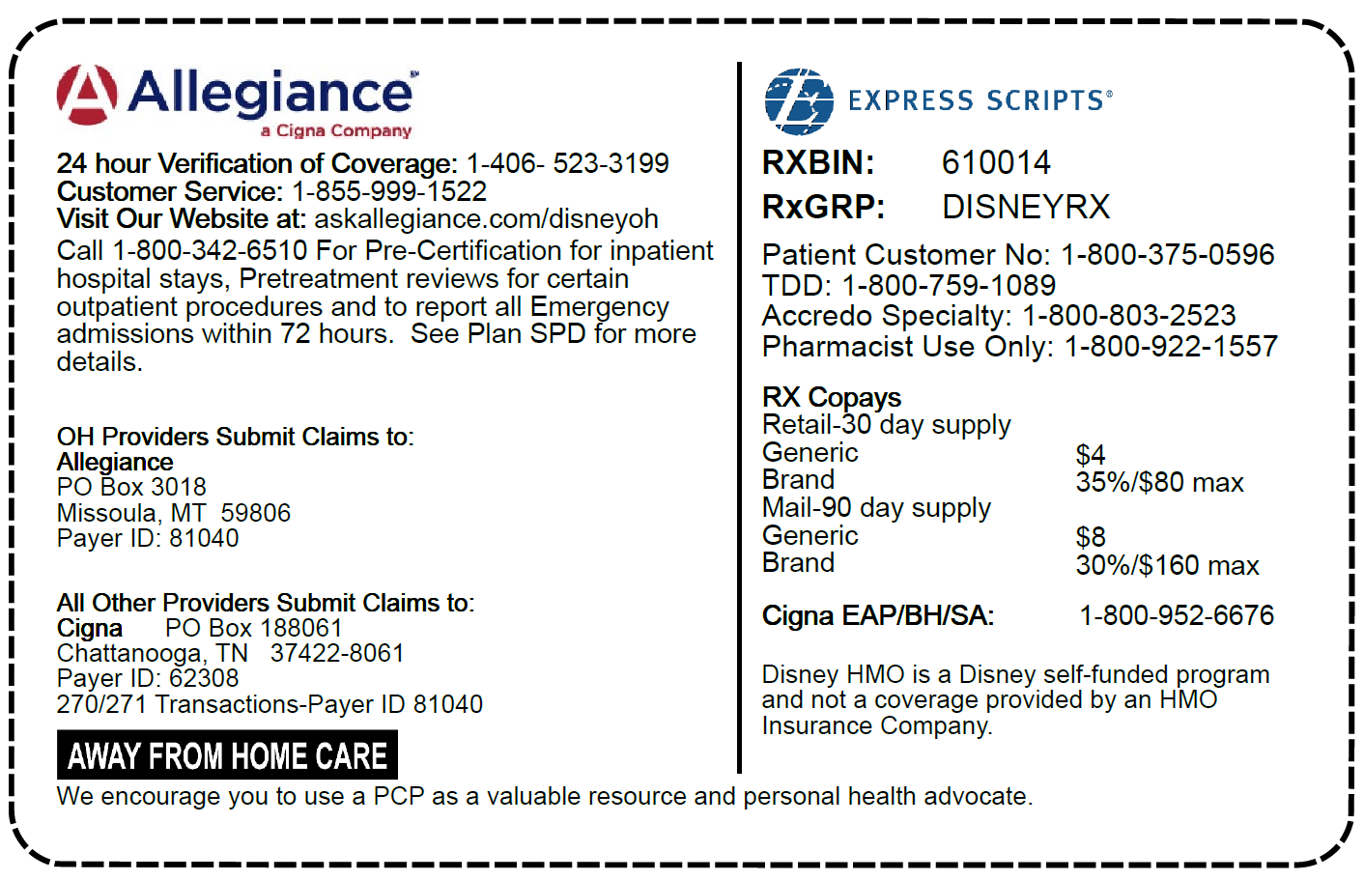
New Member Identification Cards
Sample ID Card (back)

